Slide 1


Microsoft Power BI Module 5 – Data Visualization

Slide 2
Agenda
Introduction to Data Visualization
Data VisualizationTechniques
Page Layout andFormatting
Importance of Data Visualization
Visualizations in Power BI
Working with Multiple Visuals
Charts and its formatting
Geographic Data
Filters and Slicers
Histograms
Tooltips
Bookmarks

Slide 3
Introduction to Data Visualization

Slide 4
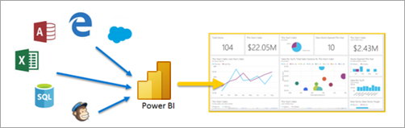
Introduction to Data Visualization
Data visualization brings data to life, using colors and shapes to present it, which would otherwise
remain as a text or numbers.
Data visualization provides an easy way to understand the represented information.

Slide 5
Importance of Data Visualization

Slide 6


Importance of Data Visualization
Easy to Understand
Every day, there is an inflation in data, and it is not easy to understand such a large quantity of data. Data visualization makes this process simple and easy
Interactive Visuals
Using these visuals, we can interact with the data in a better way. For example, we can dig deeper into a visual to obtain the detailed information from it

Slide 7

Importance of Data Visualization
Easy to Share
Data visualization makes even the sharing part easy- For example, we can share market trends or any other important information using visuals, and our team can also be responsive to it.
Personalized and Updatable
Visuals are developed based on the target audience, and they can be easily updated at any time when the data changes.

Slide 8
Data Visualization Techniques

Slide 9

Data Visualization Techniques
These are a few data visualization techniques:
Know your audience
Choose the correct visual
Limit the number of interactions between visuals use
certified custom visuals
Set a goal

Slide 10
Visualization in Power Bl

Slide 11
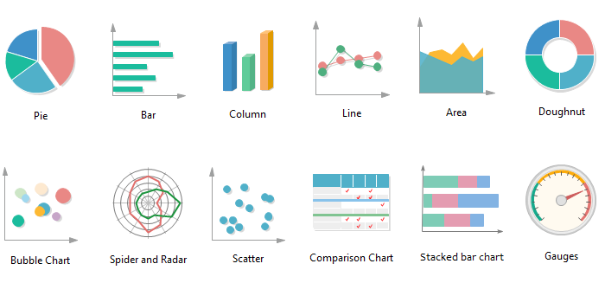
Visualization in Power Bl
Power Bl provides a wide range of visuals for data analysis

Slide 12
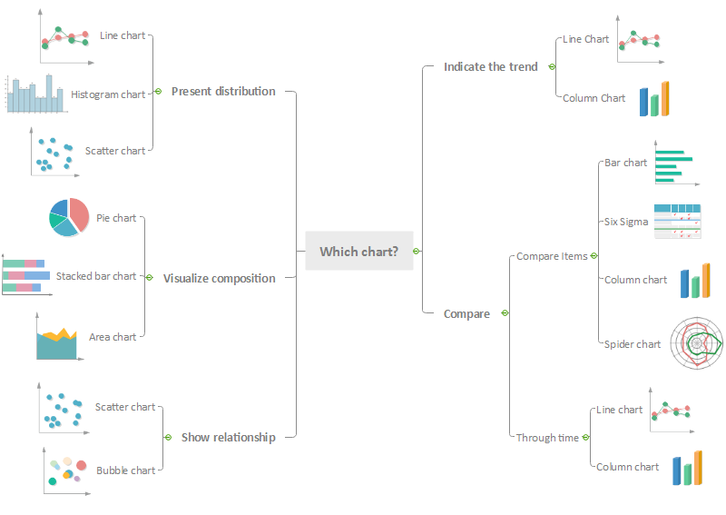

Slide 13



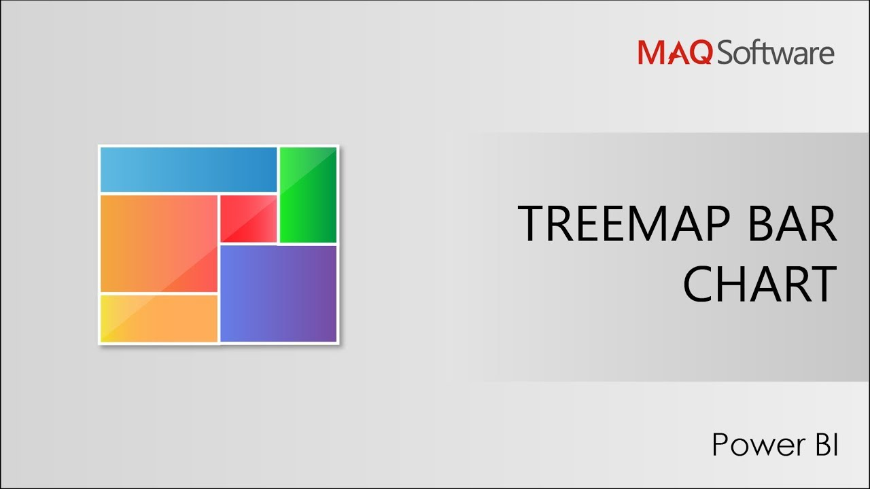
Visualization in Power Bl
Power Bl provides a wide range of visuals for data analysis
Charts
Tables
Cards
Maps
Tree Maps

Slide 14
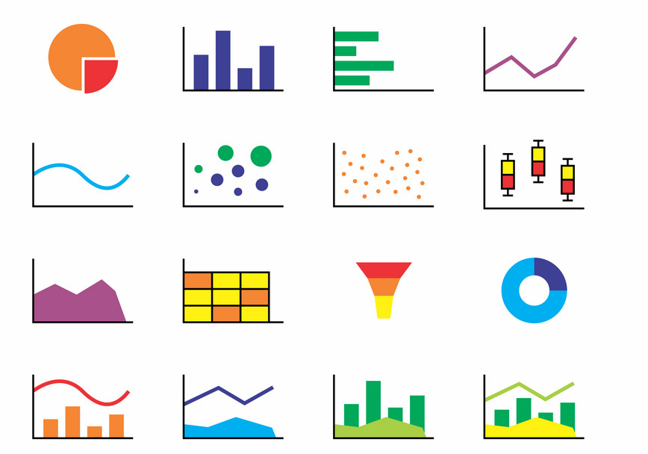
Visualization in Power Bl
We use the chart visuals in Power Bl Desktop to quickly create Visually stunning and interactive reports and
dashboards
Charts
Tables
Cards
Maps
Tree Maps

Slide 15


Visualization in Power Bl
Table visuals are used to display data in rows and
columns
Charts
Tables
Cards
Maps
Tree Maps

Slide 16
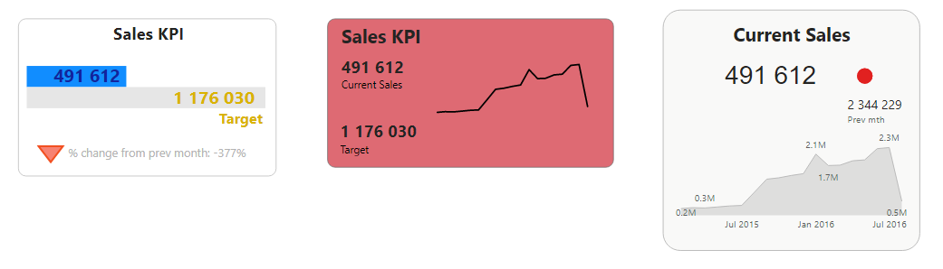
Visualization in Power Bl
A card visual displays a single numeric value. we use multi-row cards and KPIs to present the most important
data
Charts
Tables
Cards
Maps
Tree Maps

Slide 17
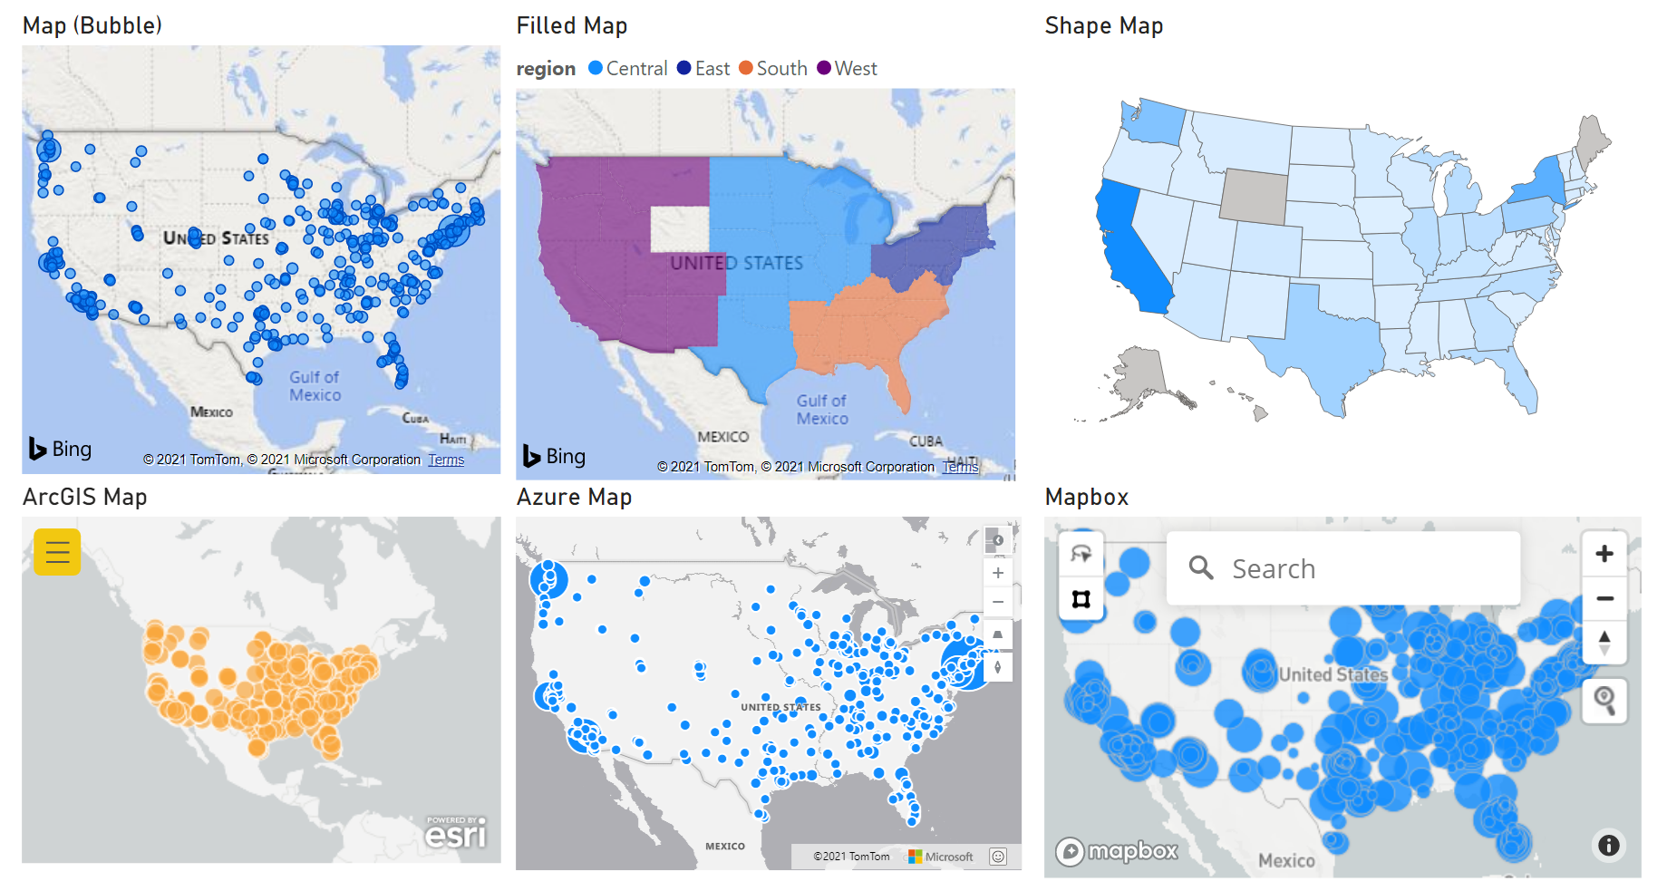
Visualization in Power Bl
Power Bl is integrated with Bing Maps to identify data locations on the map without even specifying
the longitude and latitude of the location
Charts
Tables
Cards
Maps
Tree Maps

Slide 18
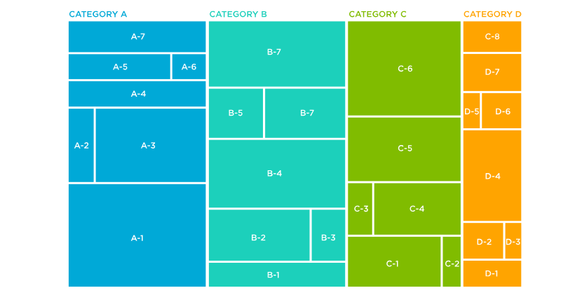
Visualization in Power Bl
Tree map visuals do not look like but represents a tree,
and they also help in data hierarchy
Charts
Tables
Cards
Maps
Tree Maps

Slide 19
Page Layout and Formatting

Slide 20

Page Layout and Formatting
Page View
We can choose the page view as 'fit to screen', 'view Actual size’, etc from the View tab
Page Size
The def:ult page size of each report is 16:9, which is suitable for most of the monitors and laptop screens. Other sizing options are also available in Power Bl Desktop
Page Name
We can give a name to each report to describe the content rather than having the default name
We can choose a color for the background or make it transparent, or even, we can have an image s the background to create a highly customized report
Page Background

Slide 21
Working with Multiple Visuals

Slide 22
Working with Multiple Visuals
Four main things to consider while working with multiple visuals
Visual Relationship
Show Items with No Data
Default Summarization and Categorization
Arrange Report Elements

Slide 23
Working with Multiple Visuals
When we click on a data point in one of the multiple visuals on our report, the other visuals respond by highlighting the corresponding data.
Visual Relationship
Visual Relationship
Highlight
None
Filter
Visual Relationship

Slide 24

Working with Multiple Visuals
This feature helps us display data that has no value, and by default,
Power Bl takes the items with no values as zero
Show Items with No Data

Slide 25
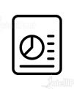
Working with Multiple Visuals
ranging report elements means sending visuals forward or backward to
create layers known as z-orders
Send
Backward
Right
Middle
Arrange Report
Elements

Slide 26
Charts and its Formatting

Slide 27
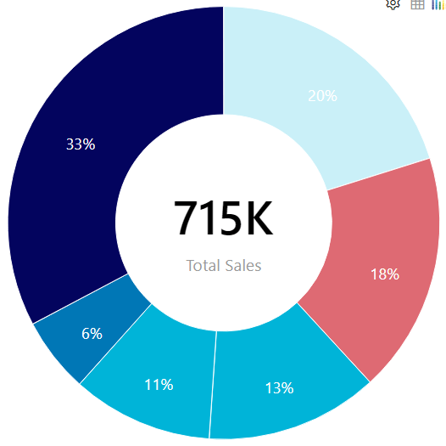
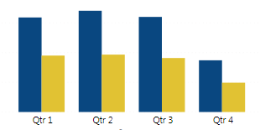
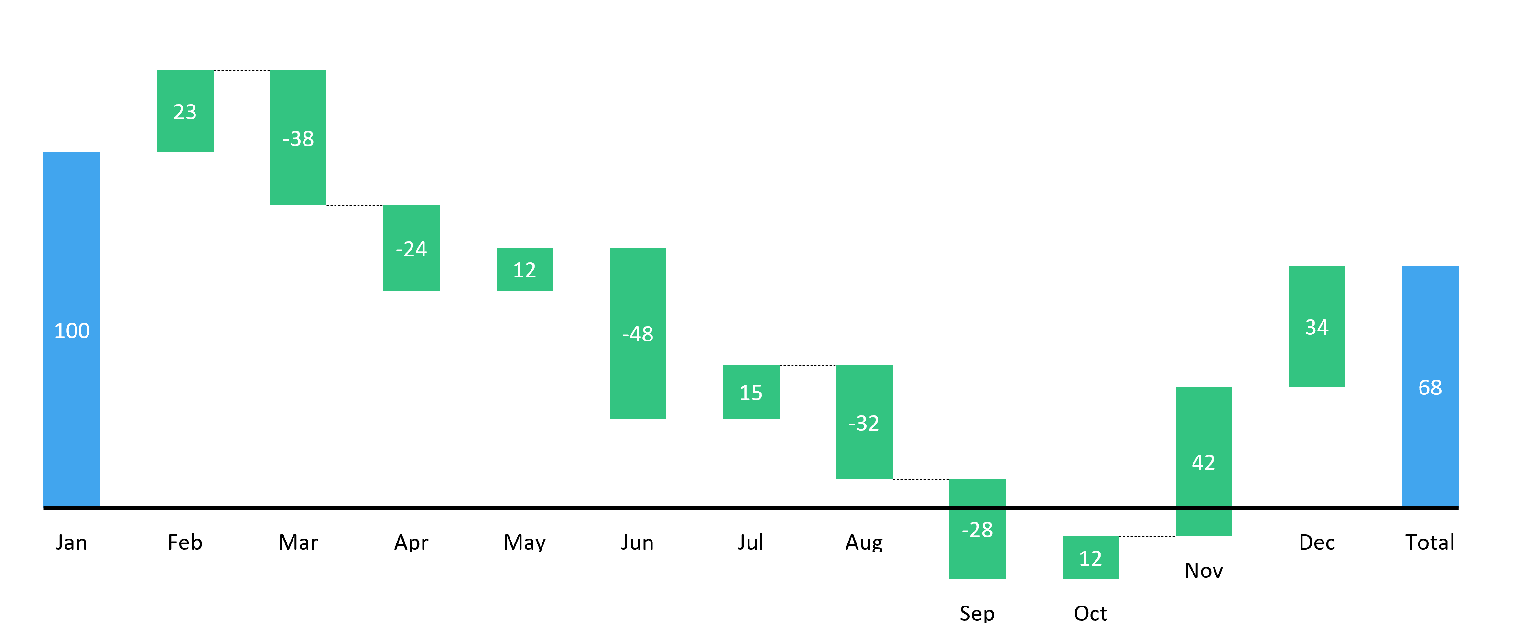
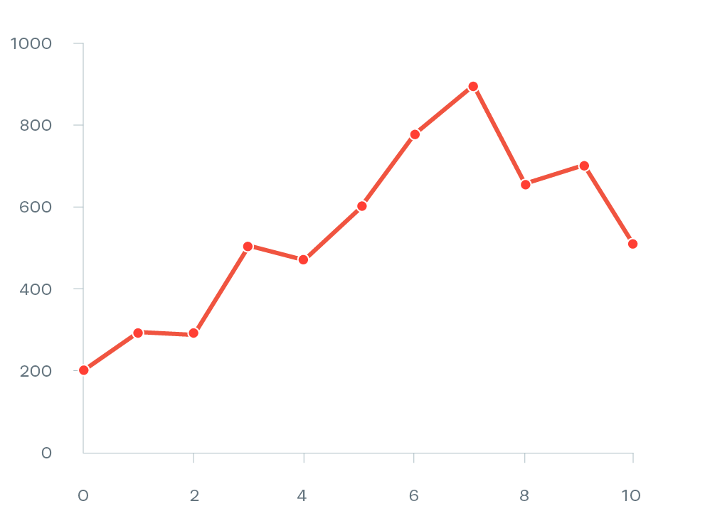
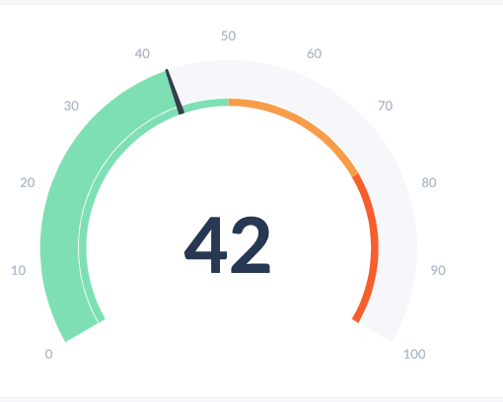
Charts and its Formatting
Column Chart
Donut Chart
Scatter Plot
Waterfall Chart
Line Chart
Gauge
The different types of chart available in Power Bl are:

Slide 28
Charts and its formatting
Each chart can be formatted based on the options available.
Formatting of charts includes changing color, background, etc. and adding title, border, and more.
We can also sort the data inside a chart based on our requirements.

Slide 29
Filters

Slide 30
Filters
01. Power Bl filters sort information and data based on a specified criteria.
02. It is used to pick and choose specific fields or values within fields to see only the information relating to it.
03. With the help of filters, irrelevant data is filtered out.

Slide 31
Types of Filters
Different types of filters in Power Bl are :
Visual level Filters
Report- level filters
The report-level filters are used to apply a filter condition to the entire report.
Page - level Filters
It is applied for a particular page. In a specific page of a report, you can apply various filter conditions.
Drillthrough Filters
This filter is used to create a page focusing on the specific entities
It is applied to an individual visualization, limiting the amount of data.

Slide 32
Slicers

Slide 33
Slicers
Slicers are yet the another way of filtering. It is useful
when you need to -
Filter by columns that are hidden and irrelevant in data tables
Create focused reports by adding slicers adjacent to essential visuals
Display important filters on report canvas for convenient access.
Makes easier to see the current filtered state.

Slide 34
Geographic Data

Slide 35
Geographic Data
In addition to the extensive list of chart types, Power Bl includes visuals to analyze geographic data
The three visuals for analyzing the geographic data are:
Map Chart
Filled Map Chart
Shape Map

Slide 36
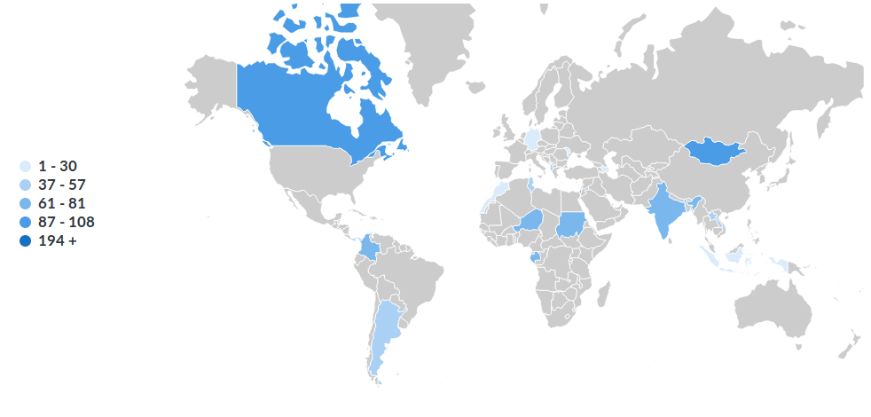
Geographic Data
The filled map chart, also known as a choropleth map, uses colors to represent data values across a geographic
area
Map Chart
Filled Map Chart
Shape Map

Slide 37
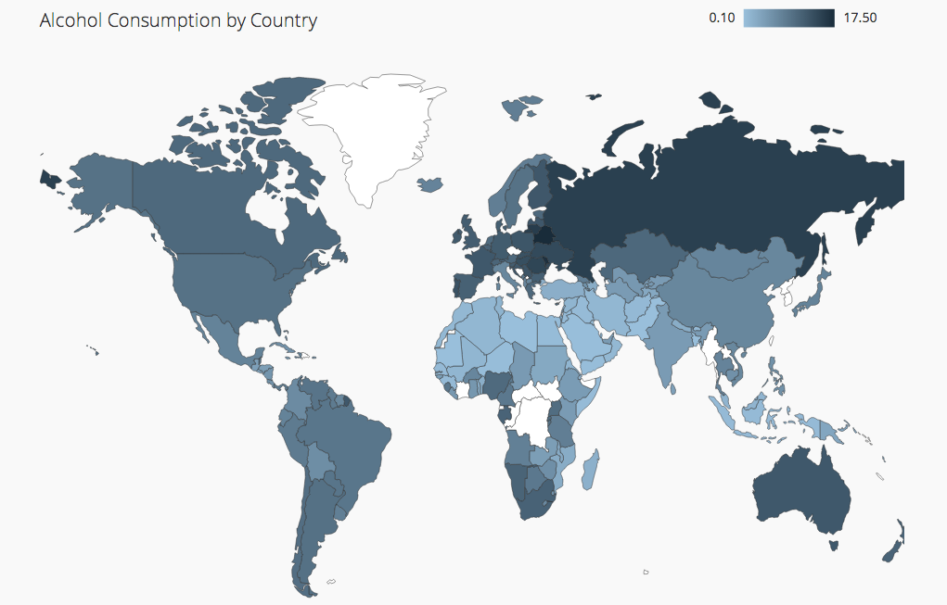
Geographic Data
A shape map is used to compare regions on the map using
colors, but it will not show the geographical location of
data points on the map
Map Chart
Filled Map Chart
Shape Map

Slide 38

Geographic Data
The filled map chart, also known as a choropleth map, uses colors to represent data values across a geographic area.
Map Chart
Filled Map Chart
Shape Map

Slide 39
Histograms

Slide 40
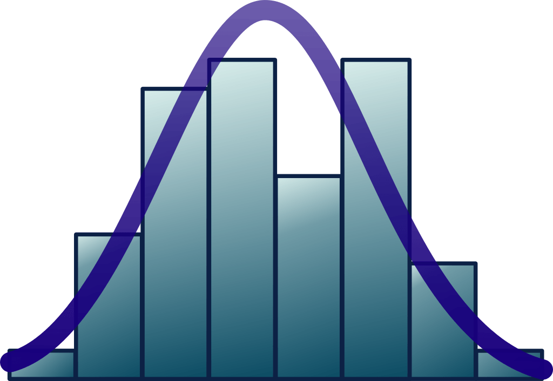
Histograms
Histograms are a graphical representation that arranges a group of data based on specified ranges
They look similar to bar charts, but there are some differences between them

Slide 41
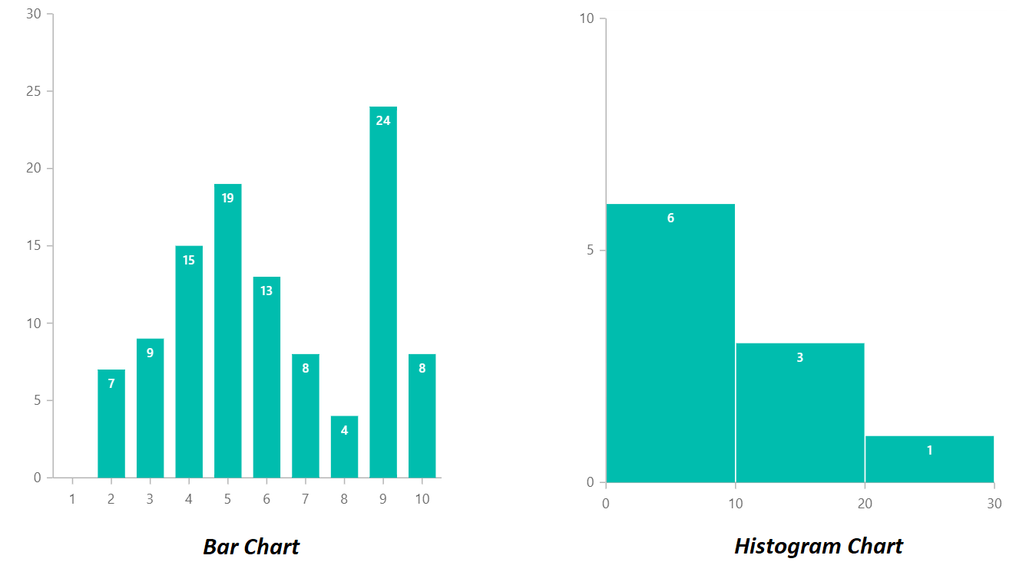
Histograms
Two fundamental differences between a histogram and a bar chart:
Differences
Each bar in a histogram is proportionally representative in size
A histogram contains no space between the bars

Slide 42
Histograms
Creating a histogram using Custom Visual
Power Bl Desktop> Get data.
In the Visualization pane, click on the Ellipsis.
Click on Import from Marketplace.
Select the certified histogram visual.
Click on the histogram chart > select Add.

Slide 43
Demo: Adding
Visualization to a
Report

Slide 44
Bookmarks

Slide 45
Bookmarks
1. The current configured view of a report is captured by Bookmarks, including the state of the visual, filters, etc…
2. There are two types Bookmarks: One used by the user and the other by the report designer itself.
3. These Bookmarks help us create stories in Power Bl and share insights.

Slide 46
Tooltips

Slide 47
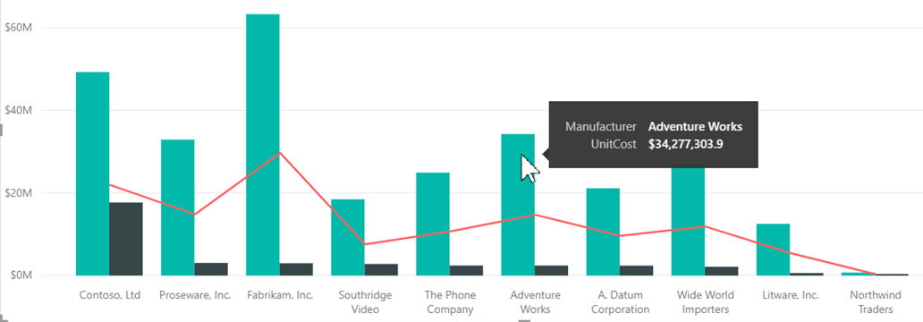
Tooltips
Tooltips are the best way to provide more conceptual information and details to our data.
The following shows a tooltip used in a chart.

Slide 48
Demo: Adding Bookmarks
and Tooltips

